Slide 1
Protecting Yourself and Client Data From Hackers
June 2021
Stop.
Take a Breath.
Observe.
Proceed.
Phishing Training
Presentation @ https://www.publiccounsel.net/train/training/resources/

Slide 2
Contents
 |  | Page
I. | Goals | 3
II. | What Is Phishing | 4
III | Phishing Examples | 7
III. | Why We Fail | 11
IV | Steps to Protect | 13
V | Clues | 14
VI | Anatomy of Phishes | 15
VII | Password | 17
VIII | Cheat Sheet | 18
Stop. Take a Breath. Observe. Proceed.
Presentation @ https://www.publiccounsel.net/train/training/resources/

Slide 3
Goals
Awareness of the issue
Impact to you and your clients
Understanding the tricks attackers use
Tools and habits to protect yourself
Signs to be vigilant for
Stop. Take a Breath. Observe. Proceed.
Presentation @ https://www.publiccounsel.net/train/training/resources/

Slide 4
What is phishing
Phishing – #1 cyber-attack
Tricks you (for profit or malice or espionage) to act against your or your client’s interest
Steals or holds hostage your identity, information or technology
Phishing types
Email – Click a link or attachment
Text message – Click a link or call a bogus number
Voicemail – Call a bogus number or company
Phone call – Call a bogus number or company
Web site – Install malware, steal credentials
Instant messaging – Account hijack, data theft, malware
No one is safe, because it is so simple and easy to phish
Stop. Take a Breath. Observe. Proceed.
Presentation @ https://www.publiccounsel.net/train/training/resources/

Slide 5
What is phishing
Phishing is used to
Steal your identity
Encrypt your data for blackmail
Blackmail to not to expose your data
Surveillance
Use your system or information to attack others
Steal intellectual property
Sabotage
Harassment
Kicks
Stop. Take a Breath. Observe. Proceed.
Presentation @ https://www.publiccounsel.net/train/training/resources/

Slide 6
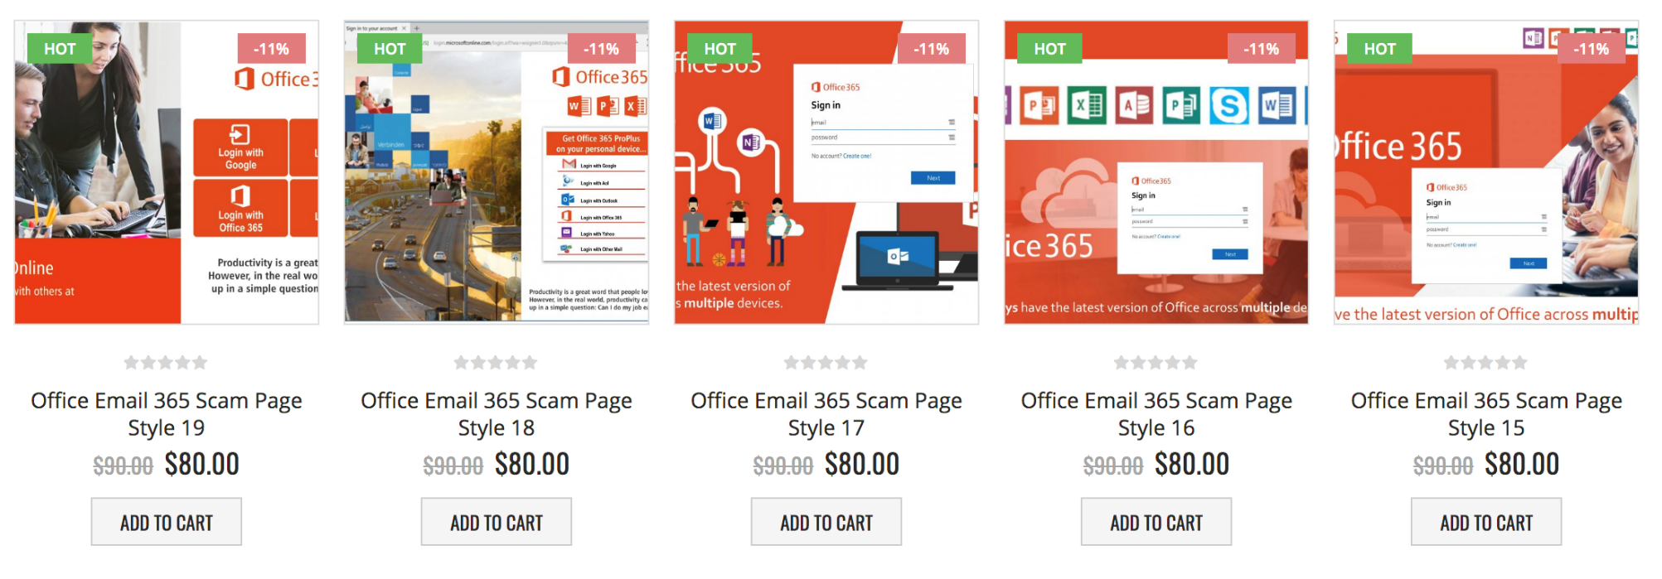
What is phishing
How hard is it to do
Surprisingly easy
Subscription services for $80/month that launch attacks and split the profits
Very profitable. Multi-billion dollar industry
Stop. Take a Breath. Observe. Proceed.
Presentation @ https://www.publiccounsel.net/train/training/resources/

Slide 7
Phishing examples
Irish Health Services – $4.4 million payment
Paralyzed Ireland’s health services for a week, cutting off access to patient records, delaying Covid-19 testing, cancellations of appointments
CPCS 2019 phishing cyber-attack
Encrypted CPCS data requiring one-month for return to full function
Hacking of the DNC in 2016 presidential election
Phishing email opened by John Podesta (chair of Clinton Presidential campaign) breached DNC systems spilling information to Wikileaks
Fake Geek Squad email claiming auto-renewing subscription
Compromised the person’s personal computer allowing hackers to access everything on their computer
Phone call claiming to be from Amazon reporting account issues
Used to trick user into installing remote access software, steal credentials, and break into financial accounts
Stop. Take a Breath. Observe. Proceed.
Presentation @ https://www.publiccounsel.net/train/training/resources/

Slide 8
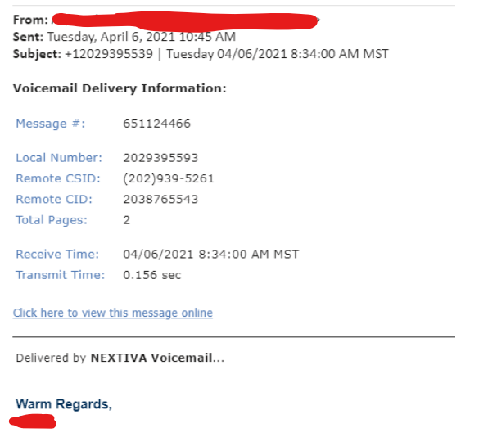
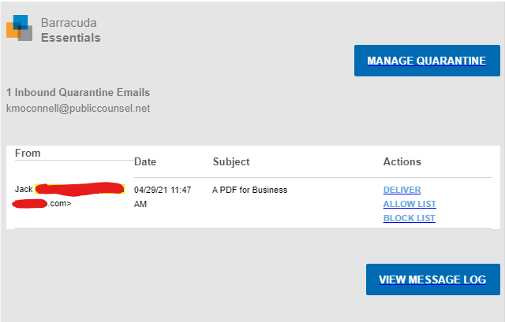
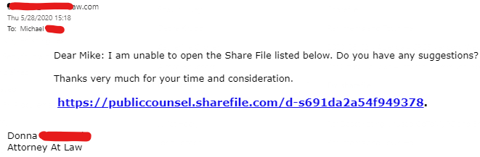
Phishing examples
Email
Stop. Take a Breath. Observe. Proceed.
Presentation @ https://www.publiccounsel.net/train/training/resources/

Slide 9
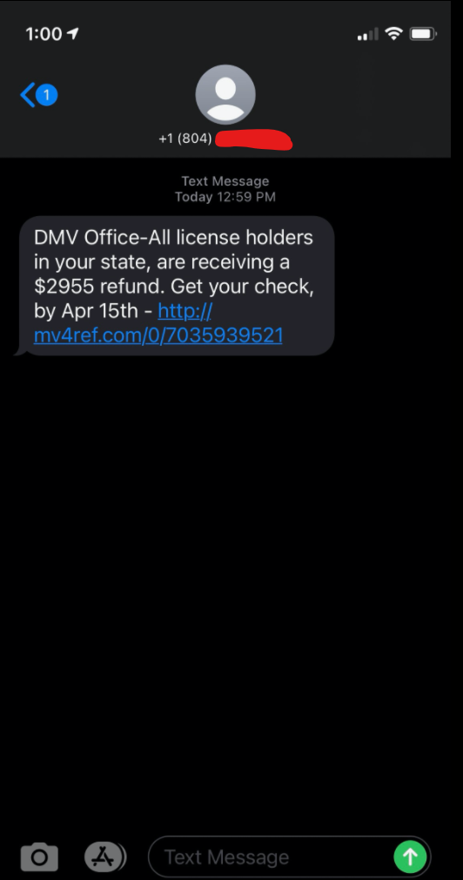
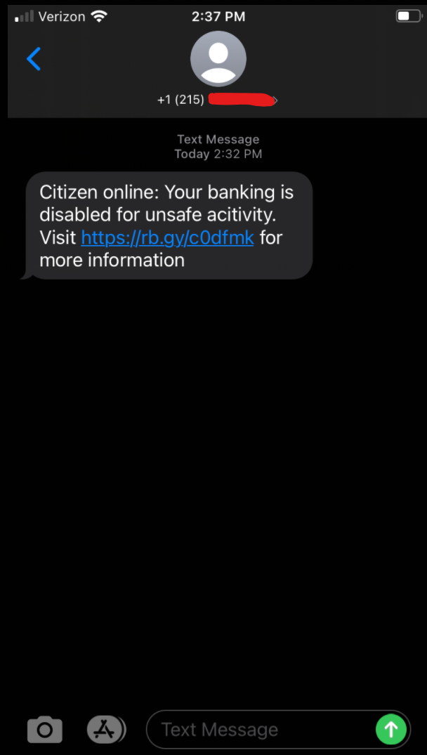
Phishing examples
SMS/Text (Smishing)
Stop. Take a Breath. Observe. Proceed.
Presentation @ https://www.publiccounsel.net/train/training/resources/

Slide 10
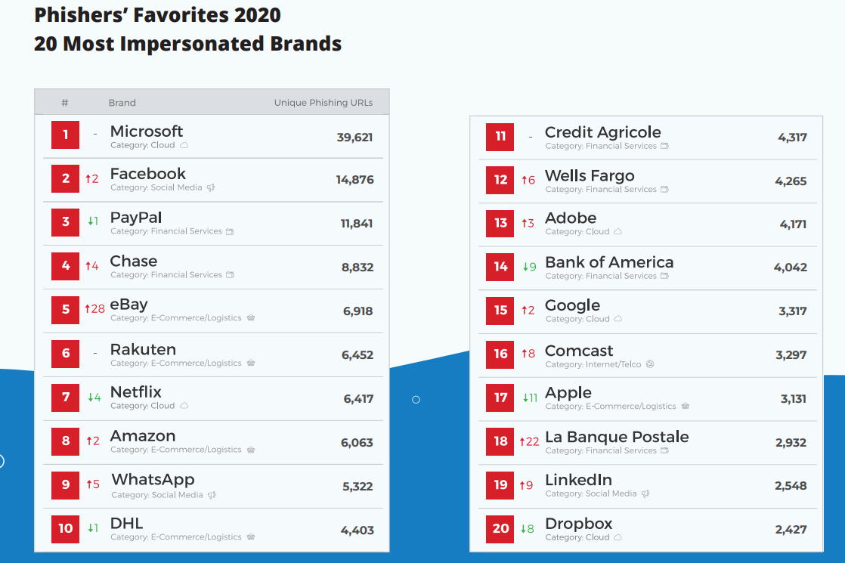
Phishing examples
Most impersonated brands in 2020 (Source: Databreachtoday.com)
Stop. Take a Breath. Observe. Proceed.
Presentation @ https://www.publiccounsel.net/train/training/resources/

Slide 11
Why we fail
What Hackers Exploit
Fear – If I don’t answer, something bad will happy or it seems urgent
Greed – Benefits will be affected. Bad credit card charge. Gift card
Curiosity – Looks interesting. What’s this about
Trust – I know this person. I work with his person. They are a partner
The #1 explanation I hear for failures: I was rushing
IQ does not correlate* with spotting phishing attacks
Smart people fail. All. The. Time
Anyone can be tricked
*Slowing down (and wearing your reading glasses) and paranoia correlate
Stop. Take a Breath. Observe. Proceed.
Presentation @ https://www.publiccounsel.net/train/training/resources/

Slide 12
Why we fail
Informative excuses
I was rushing
Sometimes you have to slow down to speed up
No email is so critical you can’t wait
Stop. Take a Breath. Observe. Proceed.
I checked it on my iPhone, which is safe
Myth. It is not safe. Phones have been compromised. Also, they can still get your private data without hacking your phone
It was from someone I know and trust
People can be ‘spoofed’ (faked) by phishers or were hacked themselves
It sounded urgent
Stop. Take a Breath. Observe. Proceed.
Stop. Take a Breath. Observe. Proceed.
Presentation @ https://www.publiccounsel.net/train/training/resources/

Slide 13
Steps to protect
Rules To Live By
Consider all email unsafe
Don’t click links or attachments
Stop. Take a Breath. Observe. Proceed.
Verify links – all links (email address, URLs, etc.)
Suspect anything asking for your username and password
Don’t rush to click links or attachments
Don’t trust the sender (even if it says it is from CPCS or your office)
Distrust generic or multiple messages
Distrust unexpected messages
Distrust messages when you are unsure why YOU are receiving it
Distrust messages when you don’t recognize other recipients
Don’t try hovering over a link on a phone or tablet – only on computers
Unique password for every account
Don’t depend on antivirus – less than 60% effective
Stop. Take a Breath. Observe. Proceed.
Presentation @ https://www.publiccounsel.net/train/training/resources/

Slide 14
Clues
Clues to look for
Requests a username or password
Generic message
Unexpected message
Unsure why YOU are receiving a message
Multiple recipients you don’t recognize
Sent at an odd hour (very early or late or on the weekend)
Urgent
Email address doesn’t match the sender name
Link address
Doesn’t match the text for the link
Has typos (e.g., americanexpress.com vs. arnericanexpress.com)
Goes to a website that doesn’t match sender (e.g., Agency email going to a non-agency web address)
Very long and complex
Unexpected attachment
Attachment is a .bat, .exe, .com (never click these)
Stop. Take a Breath. Observe. Proceed.
Presentation @ https://www.publiccounsel.net/train/training/resources/

Slide 15
Anatomy Of Phishes
Email
Generic
Why receiving
Mass person, but DC area code
Mountain time zone, but Mass person
Hover-over shows Evernote, but vendor is Nextiva
Generic
Why receiving
Hover-over shows a totally different (non-CPCS) URL
Why receiving
Stop. Take a Breath. Observe. Proceed.
Presentation @ https://www.publiccounsel.net/train/training/resources/

Slide 16
Anatomy Of Phishes
SMS/Text (Smishing)
Unexpected
Unexpected and generic. What bank
Greed. To good to be true
Fear: urgency
Url is strange. Not a bank. Get # from your bank web site and call them
Url is strange. Not a State address
Presentation @ https://www.publiccounsel.net/train/training/resources/

Slide 17
Passwords
Unique password for every web site
Do not use a common root or core for your passwords
‘How do I remember a unique password for every site,’ is a common question. Answer: you don’t
Whatever works best for you. Any solution is better than re-using passwords
Post-its, sheet of paper, rolodex, password protected note on your phone are all fine, if that works for you
Save them in your browser or iPhone keychain
Password managers
Apps for your phone/tablet (Android/iPhone/iPad) and PC (Windows/Mac) that store, create, and encrypt your passwords. Can synchronize across multiple devices
Not an endorsement. Most have an annual subscription (many have free, limited editions to try). Some prominent, cross-platform, examples are:
LastPass, Bitwarden (free), Dashlane, 1password, mSecure (one-time payment)
Stop. Take a Breath. Observe. Proceed.
Presentation @ https://www.publiccounsel.net/train/training/resources/

Slide 18
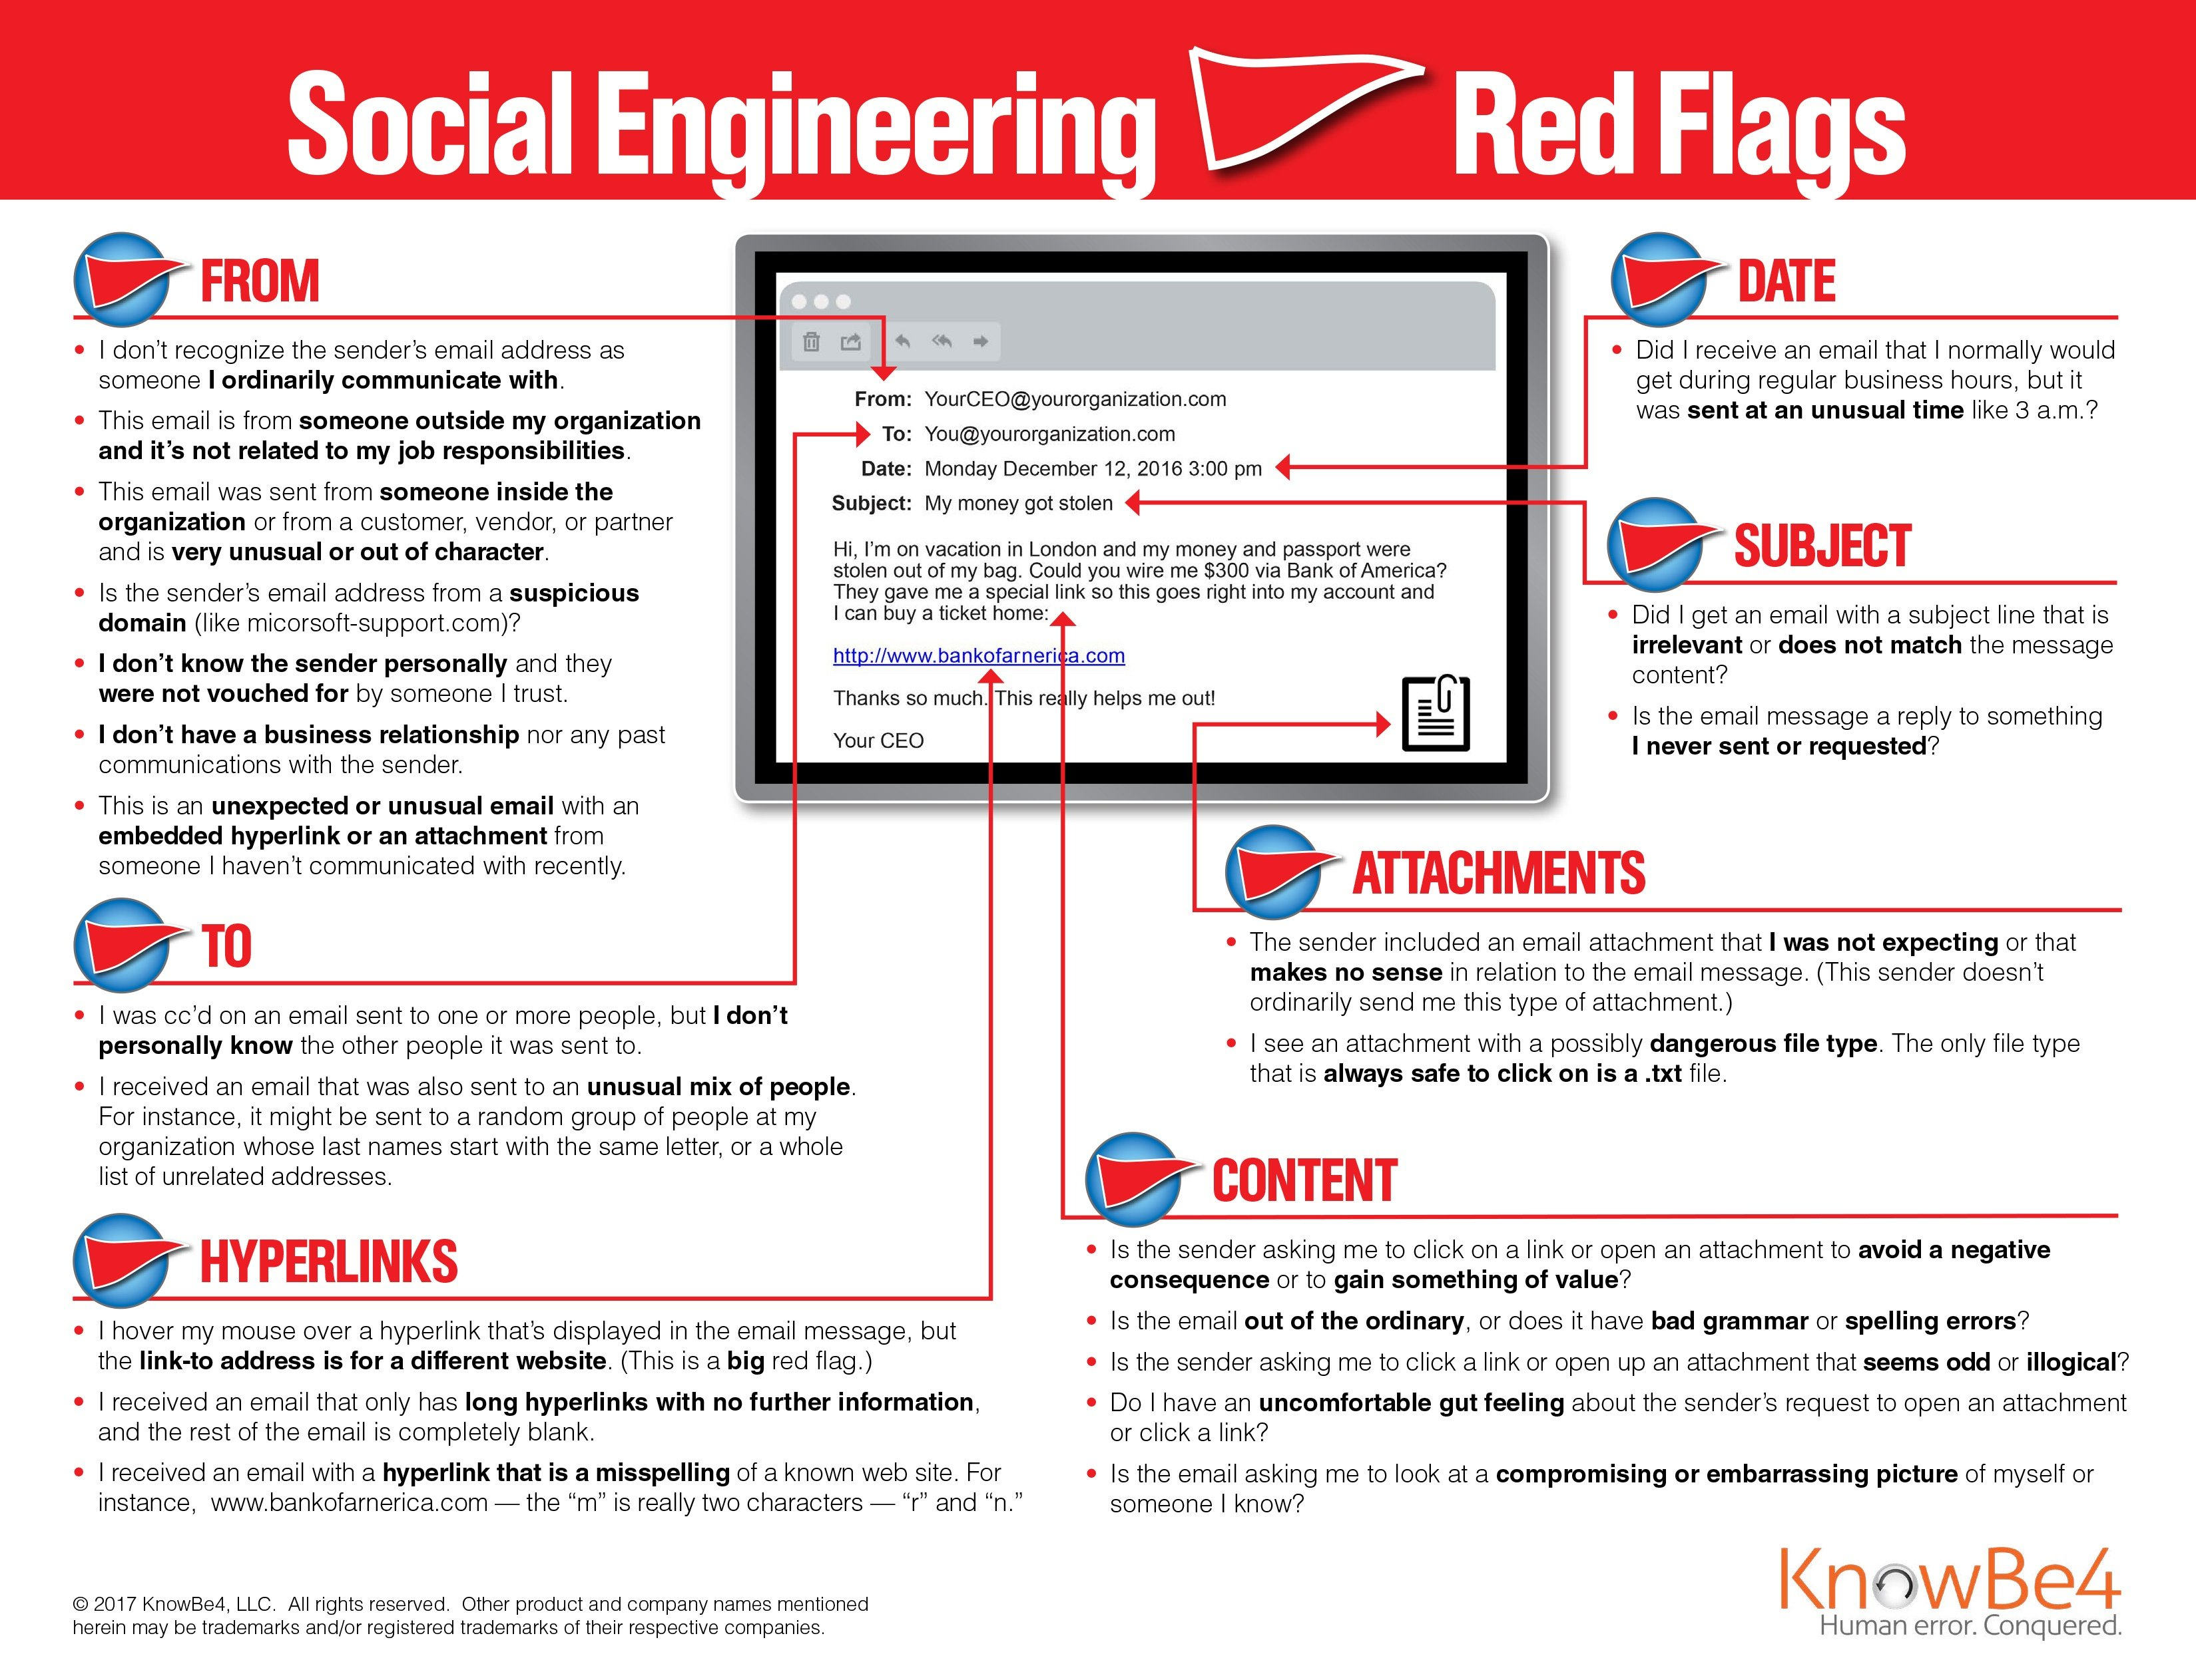
Cheat sheet – print out and have at your desk
Stop. Take a Breath. Observe. Proceed.

Slide 19
Stop.
Take a Breath. Observe.
Proceed.
Presentation @ https://www.publiccounsel.net/train/training/resources/

